Slide 1
UNDERWATER IMAGE ENHANCEMENT USING FUSION
COURSE WORK PROJECT: PARALLEL COMPUTING
Under the guidance of Prof. R.N.Chaudhary
Presented By
SHAILENDRA UPADHYAY 15154013
MAHESH PALIWAL
SHIVASHISH JENA
NIMBARAM BUGALIYA
RAHUL AGARWAL

Slide 2
GENERAL SCHEMA
The enhancing approach starts from a single distorted underwater image, first of all, applying white balance to this image to generate the first input of fusion process, denotes as img1, and applying a temporal coherent noise reduction method to this img1img1 to derive another input of fusion process, denotes as img2; then, obtaining the weights of these two inputs, where Laplacian contrast weight (WL), local contrast weight (WLC), Saliency weight (WS) and exposedness weight (WE) are used in this process; finally, the multi-scale fusion process is applied to generate the restored image.

Slide 3
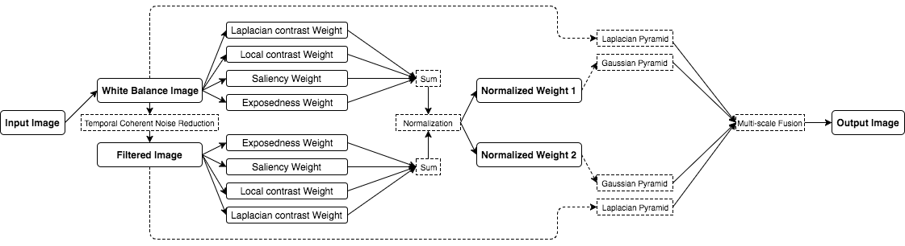
GENERAL SCHEMA

Slide 4
FUSION MATERIAL GENERATION (Input)
The first derived input is represented by the color corrected version of the image while the second is computed as a contrast enhanced version of the underwater image after a noise reduction operation is performed.

Slide 5
WHITE BALANCE
White balancing aims to enhance the image appearance by discarding unwanted color casts, due to various illuminants. Since, for underwater images, different components of light suffer from different degree of attenuation. In water deeper than 30ft30ft, white balancing suffers from noticeable effects since the absorbed colors are difficult to be restored. Additionally, underwater scenes present significant lack of contrast due to the poor light propagation in this type of medium. To deal with this problem, the author intorduces a modified balancing method according to Shades-of-Grey hypothesis, where the illumination is estimated by the value μI that is computed from the average of the scene μref and adjusted by the parameter λ:
μI=0.5+λ⋅μref

Slide 6
WHITE BALANCE(Cont.)
The average color μrefμref is used to estimate the illuminant color and can be obtained based on Minkowski norm when p=1. Practically, the first input is computed by this straightforward white balancing operation. Since the white balancing solely is not able to solve the problem of visibility, thus, an additional input is required in order to enhance the contrast of the degraded image.
To implement the color balance, I found that among different methods (including the method provided by the author), the Simplest Color Balance, which performs color balancing via histogram bormalization, is a better way to handle such process, since it is fast and the restoring performance is better.

Slide 7
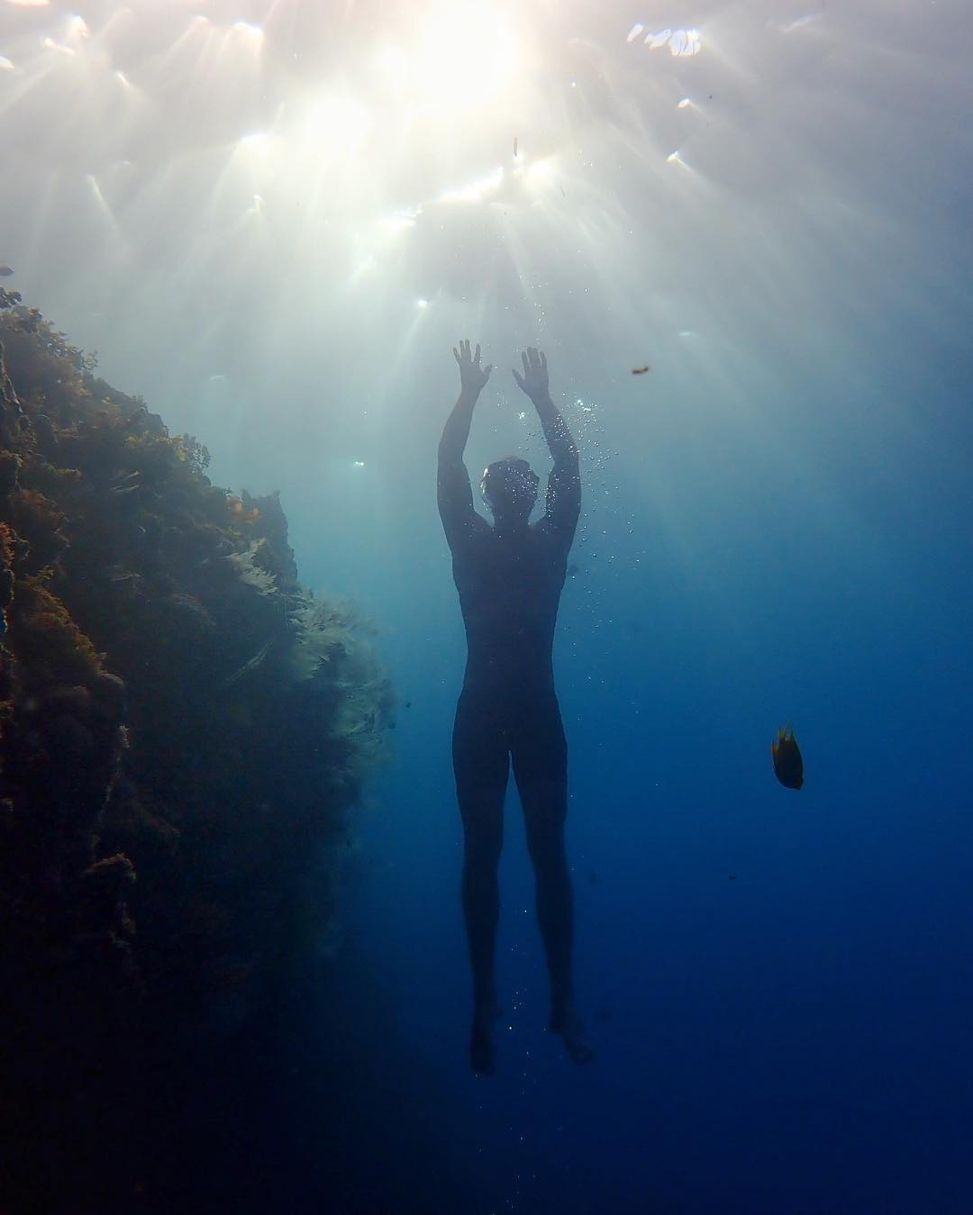
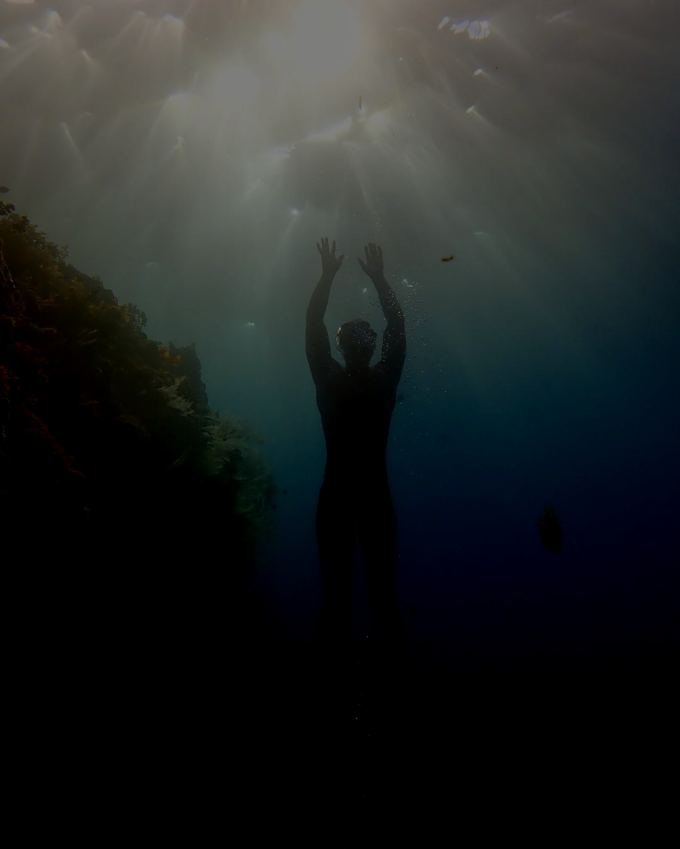
WHITE BALANCE (Input-Output)

Slide 8
TEMPORAL COHERENT NOISE REDUCTION
The temporal coherent noise reduction process is introduced, since underwater images are noisy due to the impurities and the special illumination conditions. To remove noise while preserve edges (for videos, also need to take both spatial and temporal coherence into consideration), The bilateral filter is commonly used, by considering the domain Ωof the spatial filter kernel f (Gaussian with standard deviation σf), the bilateral filter blends the center pixel s of the kernel with the neighboring pixels p that are similar to s:
Js=1k(s)∑p∈Ωf(p−s,σf)⋅g(D(p,s),σg)⋅Ip

Slide 9
NOISE REDUCTION(Cont.)
Typically, the size of neighborhood ΨΨ is 3×3 or 5×5. Practically, the second input is computed from the noise-free and color corrected version of the original image. This input is designed in order to reduce the degradation due to volume scattering. To achieve an optimal contrast level of the image, the second input is obtained by applying the classicalcontrast local adaptive histogram equalization.

Slide 10
Weights of Fusion Process
The author mentioned that the design of the weight measures needs to consider the desired appearance of the restored output. Image restoration is tightly correlated with the color appearance, and as a result the measurable values such as salient features, local and global contrast or exposedness are difficult to integrate by naive per pixel blending, without risking to introduce artifacts, thus, the fusion technique is used, which will be taken in later slides.

Slide 11
LAPLACIAN CONTRAST WEIGHT
Laplacian contrst weight deals with global contrast by applying a Laplacian filter on each input luminance channel and computing the absolute value of the filter result.
It assigns high values to edges and texture. For the underwater restoration task, however, this weight is not sufficient to recover the contrast, mainly because it can not distinguish between a ramp and flat regions. To handle this problem, we searched for an additional contrast measurement that independently assess the local distribution.

Slide 12
LOCAL CONTRAST WEIGHT
Local contrast weight comprises the relation between each pixel and its neighborhoods average. It is computed as the standard deviation between pixel luminance level and the local average of its surrounding region: WLC(x,y)=∥Ik−Ikωhc∥
where IkIk represents the luminance channel of the input and IkωhcIωhck denotes the low-passed version of it. This filtered version is obtained by employing a small 5×5 (116[1,4,6,4,1]) separable binomial kernel with the high frequency cut-off value ωhc=π2.75. For small kernels the binomial kernel is a good approximation of its Gaussian counterpart, and it can be computed more effectively.The impact of this measure is to strengthen the local contrast appearance since it advantages the transitions mainly in the highlighted and shadowed parts of the second input.

Slide 13
SALIENCY WEIGHT
Saliency weight aims to emphasize the discriminating objects that lose their prominence in the underwater scene. The saliency detection method used in this paper is Frequency-tuned Salient Region Detection proposed by Achanta et al., which is a computationally efficient saliency algorithm. However, the saliency map tends to favor highlighted areas. To increase the accuracy of results, the author introduces the exposedness map to protect the mid tones that might be altered in some specific cases.

Slide 14
EXPOSEDNESS WEIGHT
Exposedness weight evaluates how well a pixel is exposed. This assessed quality provides an estimator to preserve a constant appearance of the local contrast, that ideally is neither exaggerated nor understated. Commonly, the pixels tend to have a higher exposed appearance when their normalized values are close to the average value of 0.5. This weight map is expressed as a Gaussian-modeled distance to the average normalized range value (0.5):
WE(x,y)=exp(−(Ik(x,y)−0.5)/22σ2)
where Ik(x,y) represents the value of the pixel location (x,y) of input image Ik, while the standard deviation is set to σ=0.25.
This weight map will assign higher values to those tones with a distance close to zero, while pixels that are characterized by larger distances, are associated with the over-exposed and under-exposed regions. In consequence, this weight tempers the result of the saliency map and produces a well preserved appearance of the fused image.

Slide 15
MULTI SCALE FUSION
To yield consistent results, the author employs the normalized weight values W by constraining taht the sum at ecach pixel location of weight maps WW equals to one: Wk(bar)=Wk/(∑Kk=1Wk)
Then, generally, the enhanced image version R(x,y) is computed by fusing the defined inputs with the weight measures at every pixel location (x,y):
R(x,y)=K∑k=1¯Wk(x,y)⋅Ik(x,y)
where kk is the index of the inputs, and K=2K=2 in this paper. However, the naive approach to directly fuse the inputs and the weights introduces undesirable halos. To deal with this issue, the author introduces the Gaussian pyramid decomposition for weight maps and Laplacian pyramid decomposition for inputs. Considering that both Gaussian and Laplacian pyramids have same levels, the mixing process is performed at each level independently yielding the fused pyramid:

Slide 16
MULTI SCALE FUSION(Cont.)
Rl(x,y)=K∑k=1Gl{¯Wk(x,y)}⋅Ll{Ik(x,y)}
where ll denotes the number of the pyramid levels (l=5l=5 in this paper), LlLl is the Laplacian version while GlGl is the Gaussian version.

Slide 17
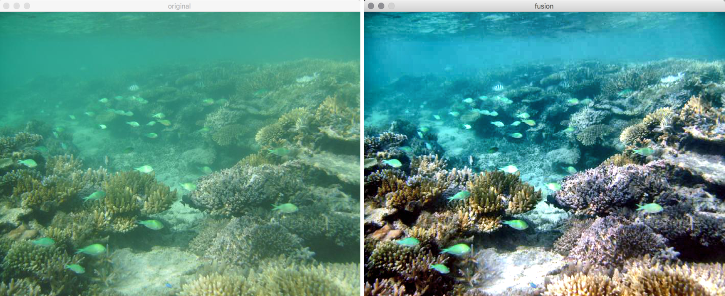
EXPERIMENTAL RESULT

